Slide 1


[Samsung PRISM] Preliminary Discussion
Deep Learning Model to classify kitchen sounds to cooking
Team
College Professor(s): Prof. Shruthi KR / Email ID
Students:
Ashmaav Sharma / Email ID
Amogh Manjunath/ Email ID
Ayush Pandey/ Email ID
Karan Balaji / Email ID
Department: Artificial Intelligence and Data Sciencel
Date: 4 March 2025

Slide 2
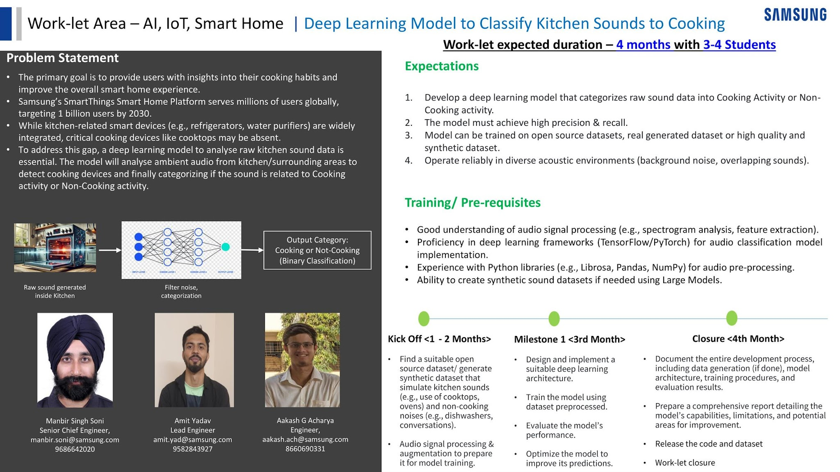
Notes:
-
2

Slide 3
Literature survey and study
Major Observations / Conclusions:
(provide details about your findings, experimental opinion – Use separate slide if necessary)
Deep Learning for Cooking Activity Recognition (MDPI, 2024): Evaluated CNN, GRU, and LSTM architectures for classifying cooking sounds. Convolutional Neural Networks (CNNs) proved the most robust and efficient architecture for this specific acoustic categorization.
Acoustic Event Recognition in High Background Noise (SciELO, 2022): Focused on identifying kitchen acoustic events at very low signal-to-noise ratios. Highlighted that identifying acoustic events in a mixture of sounds requires robust feature extraction prior to classification.
Ambient Acoustic Detection in Smart Homes (Frontiers, 2024): Validated the use of edge-ready sequence models and sequential APIs for ambient tracking, confirming audio as a superior, privacy-preserving alternative to vision AI.
The Cooking Activity Recognition Challenge Summary (2020): Highlighted that distinguishing the complex acoustic signatures of overlapping micro-activities (chopping, sizzling) remains an open challenge requiring diverse data.

Slide 4
Literature survey and study
Optimal Architecture: Convolutional Neural Networks (CNNs) analyzing visual Mel-spectrograms are the industry standard for this type of acoustic feature extraction.
The "Overlapping Sound" Bottleneck: Standard models trained on clean data fail in real-world kitchens. To operate reliably in diverse acoustic environments, the data pipeline must prioritize data augmentation—programmatically layering distractor noises (TVs, washing machines) over clean cooking audio.
Data Strategy: A perfect dataset of chaotic kitchen audio does not exist commercially. We will build a hybrid dataset utilizing sources like EPIC-Sounds (for unscripted overlap) and Google AudioSet (for "Not-Cooking" distractors)
Model Efficiency: Achieving the necessary processing speed for a smart home edge device will require aggressive optimization of the chosen PyTorch/TensorFlow framework.

Slide 5
Identified Resource Requirements
Mention any GPU/Device etc requirement here clearly.
Also mention which of these can be fulfilled at college level (Lab etc).
Hardware Requirements: Access to Cloud GPUs (e.g., Google Colab T4 or V100 instances) to handle the initial training of the CNN architecture on massive audio datasets (like the EPIC-Sounds dataset). This cannot easily be fulfilled purely on local, standard-issue laptops.
Software Requirements: Python environments configured with Librosa, Pandas, NumPy, and PyTorch/TensorFlow.
Storage Requirements: Significant cloud or local storage space to hold thousands of uncompressed .wav files and generated spectrogram images during the 1-2 month data preprocessing phase.
How Lab Resources Support the Project
Intel i7 (14th Gen CPU) -Handles audio preprocessing, feature extraction, and dataset preparation efficiently.
64 GB RAM - Supports large datasets, batch processing, and smooth model training without memory bottlenecks.
1 TB SSD Storage - Ensures fast data loading and efficient storage of datasets and model checkpoints.
NVIDIA RTX Ada 5000 GPU - Accelerates deep learning training, performs large neural network computations efficiently, and significantly reduces training time.

Slide 6
Academic Calendar Breaks (If Any)
Mention any planned academic activity (Internals/Exams/Holidays/Events/Other Internships etc) in next 6 months which will impact project timeline.
This helps in setting up the expectation of delivery timeline.

Slide 7
Queries
Challenges :
(Discuss in the form of bullets, what are the next action steps, any road blocks / bottlenecks)
Challenge: Acquiring and isolating high-quality "Cooking" audio from massive, unscripted datasets like EPIC-Kitchens without introducing mislabeled data.
Challenge: Designing a programmatic data augmentation pipeline that accurately mimics the acoustic physics of a real kitchen (e.g., the correct volume ratio of a sizzling pan versus a running dishwasher).
Challenge: Tuning the binary classifier to achieve a near-zero false-positive rate, ensuring standard household noises do not accidentally trigger a "Cooking" state in a commercial IoT environment.

Slide 8
Professor Comments
Slide to be filled in by professor (Either of two)
Please mention below points at the least:
Proposed monthly progress approach
Latest paper reviewed regarding the problem statement area
Professor Expert Insights

Slide 9
Thank you

